Slide 1
Settlers of Stepán
Aaron Dorrance, Jack Edwards, Kyle Hilbert, Sarah Holtz, James Libbey
Notes:
James

Slide 2
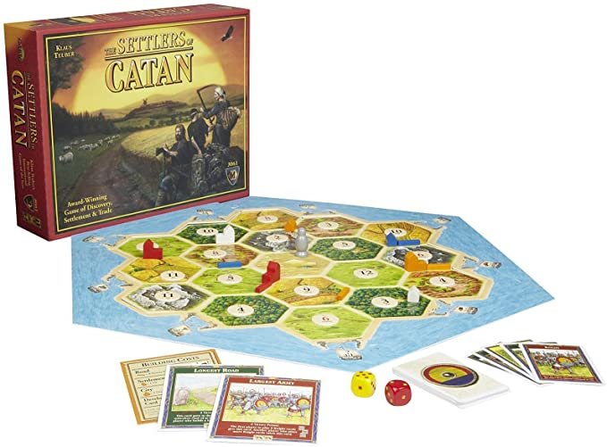
Introduction
Settlers of Catan is a multiplayer board game
Players “settlers” attempt to build and develop cities through trading and acquiring resources
We would like to design and build an electronic version, which will improve upon the game’s current flaws
Notes:
James

Slide 3
Problem Description
Notable difficulties do exist, which increase game difficulty. Ideally, these difficulties will be addressed
Determining a strong starting position can be difficult for beginners, placing them at an early disadvantage
Players commonly forget to collect resources when their number is rolled
Rules mistakes are not uncommon, but are incredibly difficult to correct
Pieces are incredibly easy to lose, which nearly ruins gameplay
Notes:
Kyle

Slide 4
Proposed Solution
Create an automated board, which will facilitate most game functions such as...
Select automated starting positions - “Quick Start”
Die rolling system
Automatic resource distribution/management system
  Including “Longest Road” and “Largest Army”
Easier construction of roads, settlements, and cities
“Failsafes” to prevent rule breaks
Notes:
Kyle

Slide 5
Demonstrated Features
The aforementioned features resolve the problems:
"Quick Start" helps new players
Automatic resources stops forgetfulness
"Failsafes" prevent accidental rules violations
Small pieces are eliminated
Notes:
Sarah

Slide 6
Available Technologies
Player input
  Buttons
  Switches
  Joystick
Individual resource display
  LCDs
Internal processing of the rules and board state
  PIC microcontrollers
  [code]
  Raspberry Pi? (for distributed I/O or processing)
The game board
  LEDs
  7 Segment Displays
  3D Printer? or other custom plastic for enclosure
Notes:
Jack

Slide 7
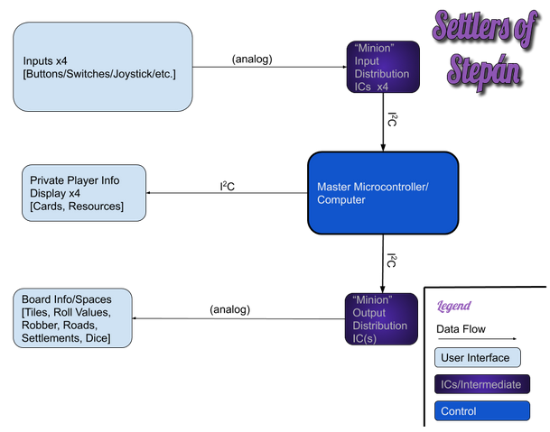
Notes:
Aaron Dorrance

Slide 8
Engineering Content
Player Input
  Circuit with all the buttons, switch, and joysticks that the player can interact with
  Connecting all the input to intermediate Microcontrollers (To have enough pins)
Main Controller/Computer
  Receives the input from input Microcontrollers
  Keeps track of game state and game rules
  Prints to individual player display through I²C
  Controllers output Microcontrollers through I²C
Individual Player display
  LCD screen which displays resource and card info of each of the players
Game Board
  LEDs that mark roads and settlements
  MOAR LEDs and 7 segment displays that mark tiles
  intermediate Microcontrollers to interface with all these (To have enough pins)
Notes:
Aaron Dorrance

Slide 9
Conclusions
Improving an existing design with substantial flaws in practical use
Can be broken up into reasonable functional blocks
Design challenges:
  Large-scale output, efficiency of microcontroller I/O
  Control mechanisms, distribution of per-player controls vs. per-game controls
  Physical design is important in this application, PCB design has to be meticulous
  User interface is top priority; selection of microcontrollers and interface components must be optimized
Notes:
James

